Slide 1
Discrete-Time Convolution and Filtering Concept
Signals and Systems Fall 2020
Prof. Dr. Adnan Kavak
Computer Engineering
Kocaeli University
Textbook: Linear Systems and Signals, B.P. Lathi
These slides are used in EE313 course at the University of Texas at Austin.
They are adopted in this course with Courtesy of Prof. Brian L. Evans

Slide 2
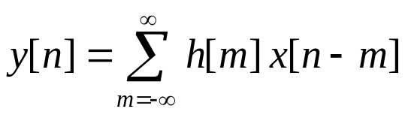
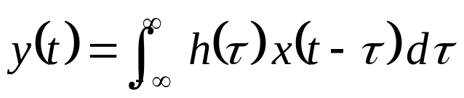
Discrete-Time Convolution
Discrete-time convolution
For every value of n, we compute a new summation
Continuous-time convolution
For every value of t, we compute a new integral
x[n]
h[n]
y[n]
x(t)
h(t)
y(t)
LTI system
represented
by its impulse
response
LTI system
represented
by its impulse
response

Slide 3
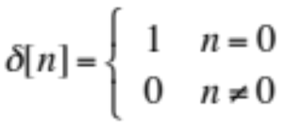
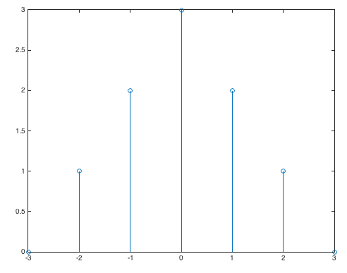
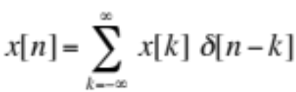
Unit Impulse Response
Discrete-time unit impulse signal δ[n]
δ[n]
δ[n-2]
1
1
n
n
-3
-2
-1
0
1
2
3
-3
-2
-1
0
1
2
3
Expressing finite-length signals using unit impulses
3 δ[n]
x[n]
3
n = -3 : 3;
x = [0 1 2 3 2 1 0];
stem(n, x);
2 δ[n+1]
2
2 δ[n-1]
δ[n+2]
1
δ[n-2]
- OR -
n
n = -3 : 3;
x = 3*tripuls(n/6);
stem(n, x);
-3
-2
-1
0
1
2
3
No MATLAB function for δ[n]
Could use rectpuls(n) but awkward

Slide 4
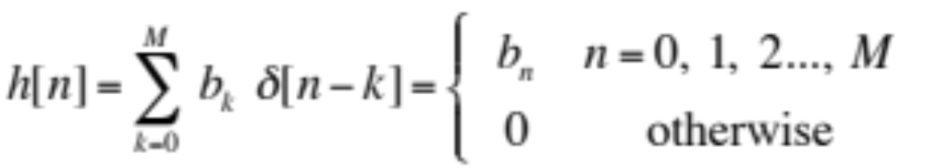
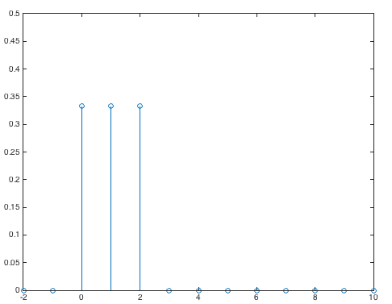
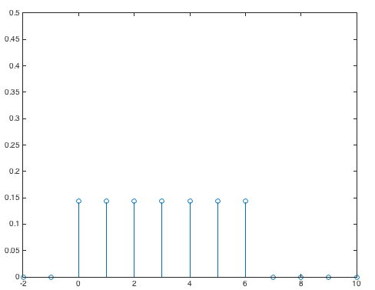
Unit Impulse Response
Output of system when unit impulse δ[n] is input
δ[n]
T{•}
h[n]
  When system is a finite impulse response filter
  Impulse responses for 3-point and 7-point averaging filters
M = 2;
n = -2 : 10;
h = rectpuls((n-1) / 3);
h = h / (M+1);
stem(n, h);
ylim( [0, 0.5] );
M = 6;
n = -2 : 10;
h = rectpuls((n-M/2) / (M+1));
h = h / (M+1);
stem(n, h);
ylim( [0, 0.5] );
7-<number>
n
n

Slide 5
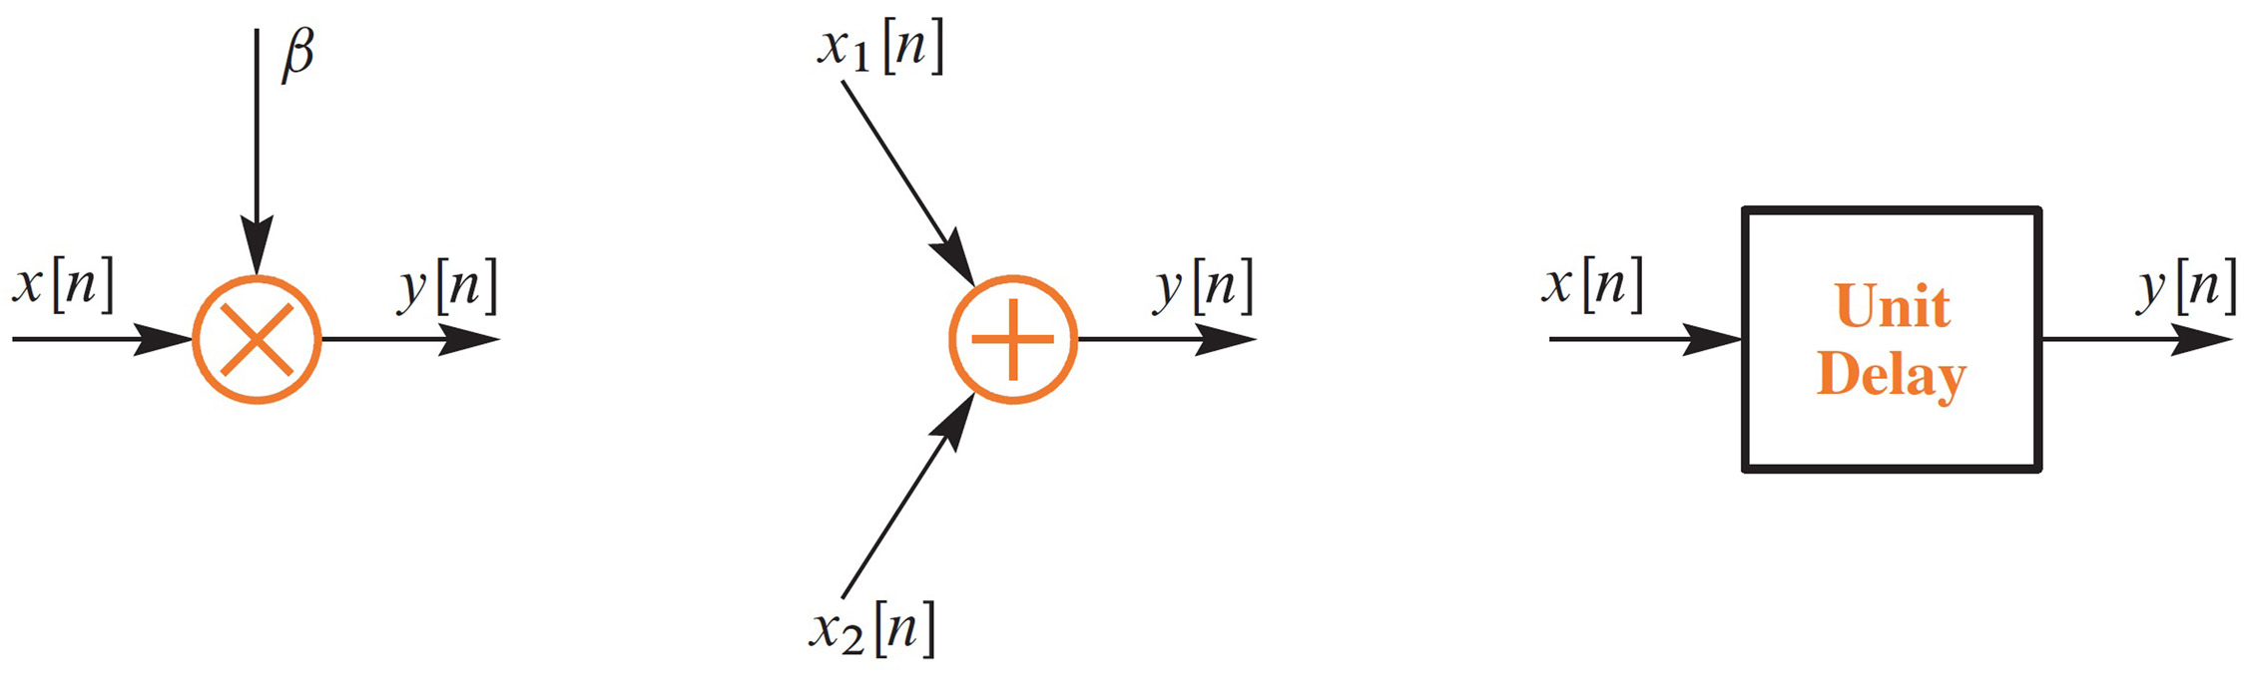



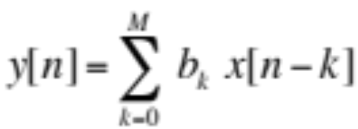
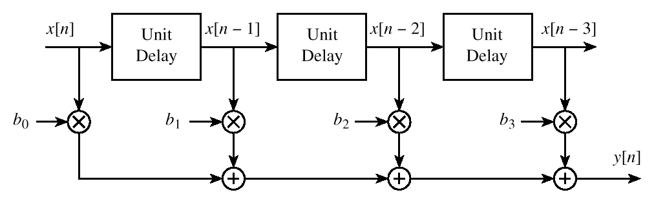
Block Diagram Representations
Discrete-time Convolution Preview

Slide 6
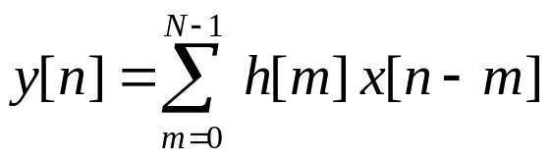
Discrete-Time Convolution Preview
Assuming that h[n] has finite
duration from n = 0, …, N-1
Block diagram of an implementation of a finite impulse response (FIR) digital filter:
flip and slide
x[n]
z⁻¹
z⁻¹
…
z⁻¹
…
h[0]
h[1]
h[2]
h[N-1]
Σ
y[n]

Slide 7
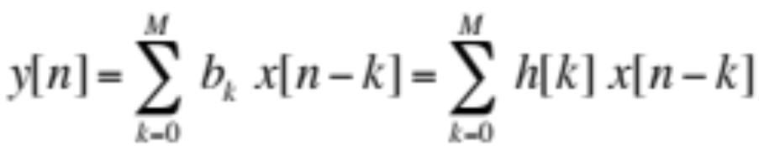
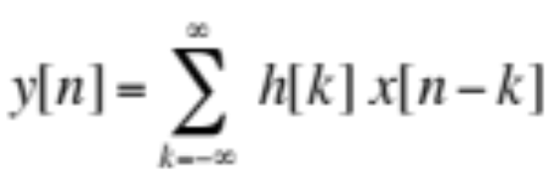
Convolution and FIR Filters
FIR filters of order M
  Input-output relationship:
  Impulse response h[n] = b_{n} for 0 ≤ n ≤ M
  Called a finite convolution sum
  Output y[n] obtained by convolving x[n] and h[n]
Convolution
  Input-output algorithm for large class of filters including FIR
  Applies to infinite-length signals
  More on general case later

Slide 8
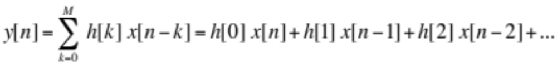
Computing Discrete Time Convolution
Expand finite convolution sum
x[n]
3
h[n]
2
1
1
-3
-2
-1
0
1
2
3
4
5
n
-1
2
3
4
n
y[n]
is one sample longer than x[n]
n | -1 | 0 | 1 | 2 | 3 | 4
x[n] | 0 | 1 | 2 | 3 | 0 | 0
h[n] | 0 | 1 | -1 | 0 | 0 | 0
h[0] x[n] | 0 | 1 | 2 | 3 | 0 | 0
h[1] x[n-1] | 0 | 0 | -1 | -2 | -3 | 0
y[n] | 0 | 1 | 1 | 1 | -3 | 0
x = [1 2 3];
h = [1 -1];
y = conv(x, h);
- OR -
x = [1 2 3 0];
h = [1 -1];
y = filter(h, 1, x);
7-<number>

Slide 9
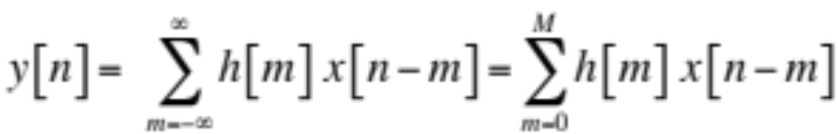

Computing Discrete Time Convolution
Impulse response h[n] has extent 0 ≤ n ≤ M
Example: Two-point averaging filter M = 1
h[n]
Averaging filter impulse response
y[n] = h[0] x[n] + h[1] x[n-1]
= ( x[n] + x[n-1] ) / 2
n
h = [1 1];
x = [0 1 2 3 2 1 0];
y = conv(h, x);
0
1
2
3
Discrete-time convolution demos
  http://spfirst.gatech.edu/matlab/#dconvdemo
  http://pages.jh.edu/~signals/discreteconv2/index.html
8-<number>

Slide 10

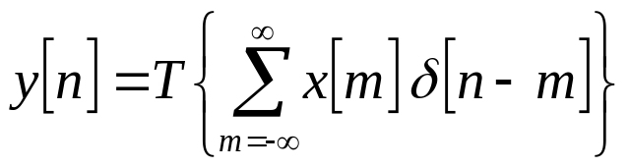
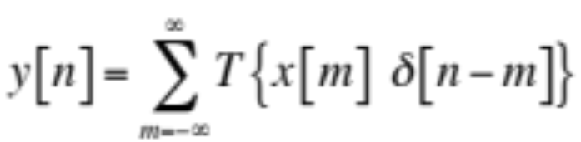
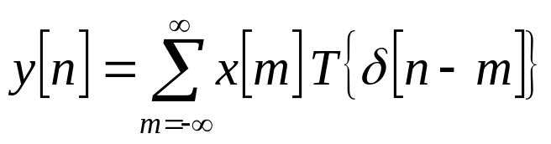
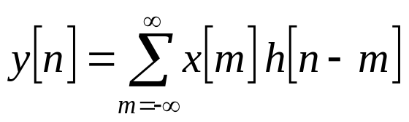
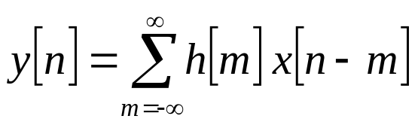
Discrete Time Convolution Properties
Output y[n] for input x[n]
Decompose x[n] into weighted sum of delayed impulses
Apply additivity
Apply homogeneity
Apply time-invariance
Apply change of variables

Slide 11
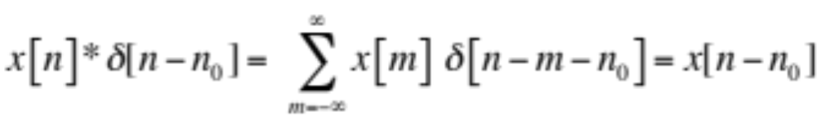
Convolution Properties
Convolution with impulse
Commutative property
  Showed this earlier on slide 8-7
Associative property
Non-zero when m = n – n₀
8-<number>

Slide 12
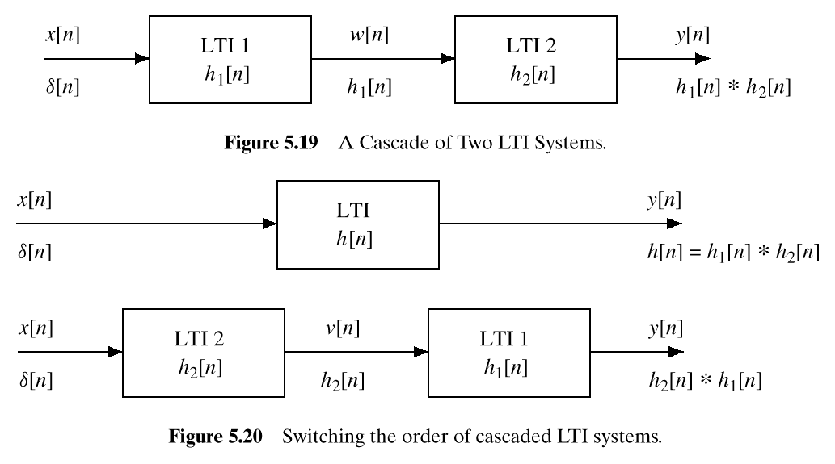
Cascaded LTI Systems
Switching the order of cascaded LTI systems
  Application of associative property of convolution

Slide 13

Running-Average Filter
Filter alters input
  Removes component or modifies characteristic
coffee filter
[Wikipedia]
Finite impulse response (FIR) filter
  Each output sample is finite sum of weighted input samples
Running-average (a.k.a. moving average) filter
  Each output sample is average of finite number of input samples
  Example: y[n] = ( x[n] + x[n+1] + x[n+2] ) / 3
sliding window
x[n]
y[n]
6
6
4
4
2
-3
-2
-1
0
1
2
3
4
5
6
7
n
-3
-2
-1
0
1
2
3
4
5
6
7
n

Slide 14
Running-Average Filter
Noncausal filter
  Uses future input values (as in example on previous slide)
  Buffer input signal before computing nth output sample
Causal filter
  Only uses present and past input values
  Compute nth output sample when nth input sample arrives
  Example: y[n] = ( x[n] + x[n-1] + x[n-2] ) / 3
sliding window
x[n]
y[n]
6
6
4
4
2
-3
-2
-1
0
1
2
3
4
5
6
7
n
-3
-2
-1
0
1
2
3
4
5
6
7
n

Slide 15
General FIR Filter
Causal FIR filter
  Sliding window of M+1 samples
  M+1 filter coefficients b₀, b₁, …, b_{M}
  Vector dot product of [b₀ b₁ … b_{M}] and [x[n] x[n-1] … x[n-M]]
Averaging filter
  Three terms: filter order M = 2 and b_{k} = 1/3 for k = 0, 1, 2
  General case: b_{k} = 1/(M+1) for k = 0, 1, …, M
Coefficients completely define filter
  Example: { b_{k} } = { 1, -1 } gives y[n] = x[n] – x[n-1]
  Example: { b_{k} } = { 1, 0, -1 } gives y[n] = x[n] – x[n-2]
7-<number>

Slide 16
FIR Filtering
Signal is sum of increasing exponential & sinusoid
  x[n] = (1.02)^{n} + ½ cos((2 π / 8) n + π / 4) for 0 ≤ n ≤ 40
Apply causal 3-point and 7-point averaging filters
  b = { b_{k} } = { 1/3, 1/3, 1/3 } where M = 2
  b = { b_{k} } = { 1/7, 1/7, 1/7, 1/7, 1/7, 1/7, 1/7 } where M = 6

Slide 17
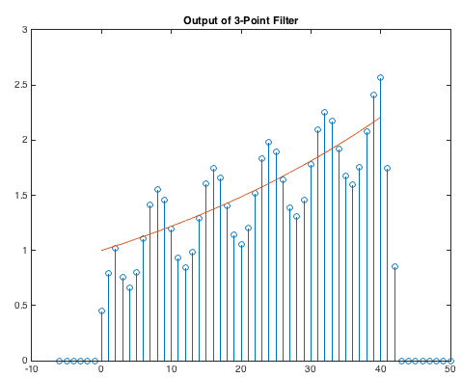
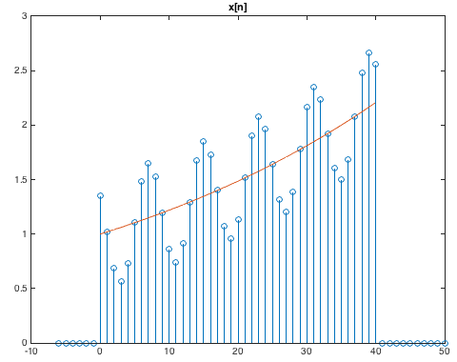
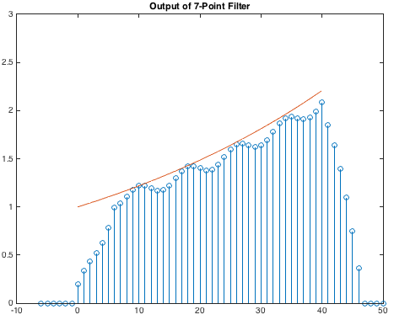
FIR Filtering
n
n
n

Slide 18
FIR Filtering (MATLAB Code)
% Define x[n] for 0<=n<=40
n = 0 : 40;
x1 = (1.02).^n;
x2 = 0.5*cos((2*pi/8)*n + pi/4);
x = x1 + x2;
% Save n and x1 for plotting trend
t = n;
x1t = x1;
% Define x[n] for -6<=n<=50
n0 = 6;
n = [ (-n0:-1) n (41:50) ];
x = [ zeros(1,n0) x zeros(1,10) ];
x1 = [ zeros(1,n0) x1 zeros(1,10) ];
% Define filter coefficients
b3coeff = (1/3)*ones(1,3);
b7coeff = (1/7)*ones(1,7);
% Filter data
y3 = filter(b3coeff, 1, x);
y7 = filter(b7coeff, 1, x);
% Plot results
figure;
stem(n, x);
title('x[n]'); ylim([0 3]);
hold on; plot(t, x1t); hold off;
figure;
stem(n, y3);
title('Output of 3-Point Filter'); ylim([0 3]);
hold on; plot(t, x1t); hold off;
figure;
stem(n, y7);
title('Output of 7-Point Filter'); ylim([0 3]);
hold on; plot(t, x1t); hold off;
Note: filter(b, 1, x) command
7-<number>
Filter coefficients
Input signal

Slide 19


Audio Example
Signal is sum of three B notes on Western scale
  Where f_{B6} = 1975.53 Hz, f_{B4} = 493.883 Hz, f_{B2} = 123.471 Hz
  With sampling rate f_{s} = 8000 Hz and
  Note: f_{B6} = ¼ f_{B4} and f_{B4} = ¼ f_{B2} due to octave spacing
Filter signal with 4-point averaging filter
  b = { b_{k} } = { 1/3, 1/3, 1/3 } where M = 2
Filter signal with 16-point averaging filter
  b = { b_{k} } = { 1/16, 1/16, 1/16, …, 1/16 } where M = 15
What differences do you hear?

Slide 20
Audio Example (MATLAB code)
% Set sampling rate and duration
fs = 8000;
tmax = 3;
nmax = round(fs * tmax);
n = 1 : nmax;
% E note in three different octaves
B6 = 1975.53; % Hz
B4 = B6/4;
B2 = B4/4;
f = [ B6 B4 B2 ];
wHat = 2*pi*f/fs;
a = [ 1 1 1 ];
x = zeros(1, length(n));
for i = 1 : length(wHat)
x = x + a(i)*cos(wHat(i)*n);
end
% Scale amplitude to be in [-1, 1]
x = x / max(abs(x));
% Filter signal of 3 notes
average4 = (1/4)*ones(1,4);
y4 = filter(average4, 1, x);
average16 = (1/16)*ones(1,16);
y16 = filter(average16, 1, x);
% Play sounds to keep same volume level
soundsc(x, fs);
pause(tmax+1);
soundsc(y4, fs);
pause(tmax+1);
soundsc(y16, fs);
Note: filter(b, 1, x) command
Filter coefficients
Input signal

